Slide 1
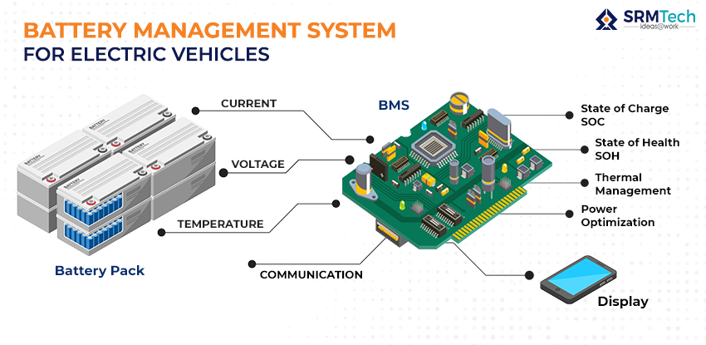
Battery Management in Electric Vehicles
Overview of Battery Technologies , Management Systems , and Future Trends

Slide 2
Topics To Be Discussed
Introduction
Components of a Battery Management System
Importance of Battery Management In EVS
Battery Manegement Challenges
Future Trends In Battery Management

Slide 3
Introduction to Battery Management in EVS
Battery management systems (BMS) are critical for the performance and longevity of electric vehicles (EVs). They oversee battery health, monitor voltage, temperature, and state of charge, ensuring optimal operation and safety. A BMS balances individual cell performance, prevents overcharging or deep discharging, and facilitates communication between the battery pack and the vehicle's control systems. By optimizing battery usage, a BMS enhances energy efficiency, extends lifespan, and improves overall vehicle reliability, playing a vital role in the widespread adoption of EV technology.

Slide 4
Components of a Battery Management System (BMS)
A Battery Management System (BMS) is crucial for monitoring and managing battery performance, ensuring safety, and maximizing lifespan. Here are the key components of a BMS:
Voltage Monitoring: Measures the voltage of individual cells to ensure they operate within safe limits.
Current Monitoring: Tracks the current flowing in and out of the battery to prevent overcurrent conditions.
Temperature Sensors: Monitors the temperature of the battery cells, as excessive heat can lead to degradation or failure.
State of Charge (SOC) Estimation: Calculates the remaining capacity of the battery, often using algorithms like Coulomb counting or Kalman filtering.
State of Health (SOH) Estimation: Assesses the overall condition of the battery, indicating how much capacity has been lost over time.

Slide 5
6 .Communication Interface: Provides data exchange between the BMS and other systems (like a vehicle controller or external monitoring system) through protocols such as CAN, RS-485, or Bluetooth.
7 .protection Circuits: Includes fuses and circuit breakers to protect against overvoltage, undervoltage, overcurrent, and thermal runaway.
8 .Control Algorithms: Implements software routines for decision-making, optimizing performance, and managing charging and discharging cycles.
9.User Interface: Displays information to the user, such as SOC, SOH, and any alerts or warnings.
These components work together to enhance the safety, reliability, and efficiency of battery systems in applications like electric vehicles, renewable energy storage, and consumer electronics.

Slide 6
Importance Of Battery Management
Battery management is crucial for several reasons:
Safety: Proper management prevents overcharging, overheating, and short circuits, which can lead to battery failure or fires.
Performance: Effective management optimizes the charging and discharging processes, ensuring that the battery operates at its best and delivers consistent performance.
Longevity: Monitoring and controlling charge cycles can significantly extend a battery's lifespan. By avoiding deep discharges and maintaining optimal charge levels, batteries can last much longer.
Efficiency: Battery management systems (BMS) can enhance energy efficiency by balancing charge levels across individual cells in a battery pack, reducing energy waste.
Health Monitoring: A BMS can provide real-time data on battery health, helping to detect issues early and enabling predictive maintenance.

Slide 7
6. Environmental Impact
Sustainable Practices: Effective battery management encourages recycling and proper disposal, minimizing environmental harm.
Integration with Renewable Energy: BMS is essential for optimizing the use of batteries in solar or wind energy systems, contributing to cleaner energy solutions.
7. Integration with Technology
Smart Technologies: BMS allows for integration with IoT and smart grids, facilitating better energy management and usage patterns.
User Experience: Improved battery management enhances the overall user experience in devices, ensuring longer usage times and reliable performance.
8. Regulatory Compliance
Standards Adherence: Many industries have strict regulations regarding battery safety and performance, making effective management essential for compliance.

Slide 8
Battery Management Challenges
Battery management presents several challenges, particularly as the demand for energy storage and electric vehicles grows. Here are some key challenges:
Battery Life and Degradation: Understanding how to extend the lifespan of batteries while minimizing capacity loss over time is critical. Factors like cycling, temperature, and charging habits significantly affect battery health.
Temperature Control: Batteries operate best within specific temperature ranges. Overheating can lead to reduced performance and safety risks, while extreme cold can affect efficiency. Effective thermal management systems are essential.
Safety Concerns: Lithium-ion batteries can pose risks of overheating, fires, or explosions if damaged or improperly managed. Ensuring safety through robust designs and monitoring systems is vital.
State of Charge (SoC) and State of Health (SoH) Estimation: Accurately determining a battery's charge level and overall health is challenging, especially as batteries age. Advanced algorithms and models are necessary for reliable estimations.
Balancing Cells: In battery packs, individual cells can have different capacities and charge levels. Balancing these cells to ensure even usage and prevent overcharging is crucial for performance and safety.

Slide 9
6 .Integration with Renewable Energy: Managing the charge and discharge of batteries in conjunction with variable renewable energy sources (like solar or wind) poses challenges in terms of timing and capacity management.
7 .End-of-Life Management: Developing effective recycling processes and repurposing strategies for used batteries is important for sustainability and reducing environmental impact.
8 .Cost and Scalability: The high cost of advanced battery technologies and the need for scalable solutions can hinder widespread adoption.
9 .Regulatory Compliance: Navigating the complex landscape of regulations and standards regarding battery safety, transportation, and disposal can be challenging for manufacturers.
10.Supply Chain Issues: The sourcing of raw materials (like lithium, cobalt, and nickel) can be affected by geopolitical factors and environmental concerns, impacting battery production and availability.

Slide 10
Future Trends in Battery Management
1. Solid-State Batteries
Solid-state batteries promise higher energy density, improved safety, and faster charging times compared to traditional lithium-ion batteries. They use a solid electrolyte instead of a liquid one, reducing the risk of leaks and fires.
2. Lithium-Sulfur Batteries
Lithium-sulfur (Li-S) batteries are emerging as a potential alternative to lithium-ion batteries, offering higher theoretical energy densities. Research is ongoing to address challenges such as cycle stability and conductivity.
3. Recycling and Sustainability
As battery production scales up, recycling technologies will become crucial. Innovations in battery recycling can reduce the need for raw materials, minimize environmental impact, and create a circular economy for batteries.

Slide 11
4. Advanced Materials
Research into new materials, such as graphene, silicon anodes, and metal-air batteries, is expected to enhance performance. These materials can provide higher capacities and longer lifespans.
5. Fast Charging Technologies
As consumer demand for quick charging increases, advancements in fast-charging technologies will be pivotal. Innovations may reduce charging times to minutes, making electric vehicles more convenient.
6. Wireless Charging
Wireless charging technologies, especially for electric vehicles, are gaining traction. This trend could lead to more convenient charging solutions in urban environments.
7. Battery Management Systems (BMS)
Smart BMS will become increasingly sophisticated, allowing for better monitoring and optimization of battery performance, longevity, and safety through advanced algorithms and AI.

Slide 12
8. Grid Energy Storage
As renewable energy sources like solar and wind expand, large-scale battery systems will play a critical role in balancing supply and demand, enabling grid stability and energy storage.
9. Hydrogen Fuel Cells
While not a battery in the traditional sense, hydrogen fuel cells offer a complementary energy storage solution. They are gaining attention for applications in transportation and heavy industries.
10. Second-Life Applications
Used EV batteries can be repurposed for stationary energy storage applications, extending their life and providing cost-effective solutions for renewable energy integration.
These trends reflect a shift toward more efficient, sustainable, and versatile energy storage solutions, crucial for addressing global energy challenges in the coming years.

Slide 13
Conclusion
A well-designed BMS is essential for the safety, longevity, and performance of electric vehicle batteries. Ongoing innovations in battery management systems will continue to enhance the efficiency, safety, and functionality of future electric vehicles.

